Slide 1
ASOCIACIÓN ESPAÑOLA DE FARMACÉUTICOS DE LA INDUSTRIA
Spanish Association of Pharmacists in Industry
EIPG General Assembly (Madrid, 10-11 May 2025)

Slide 2
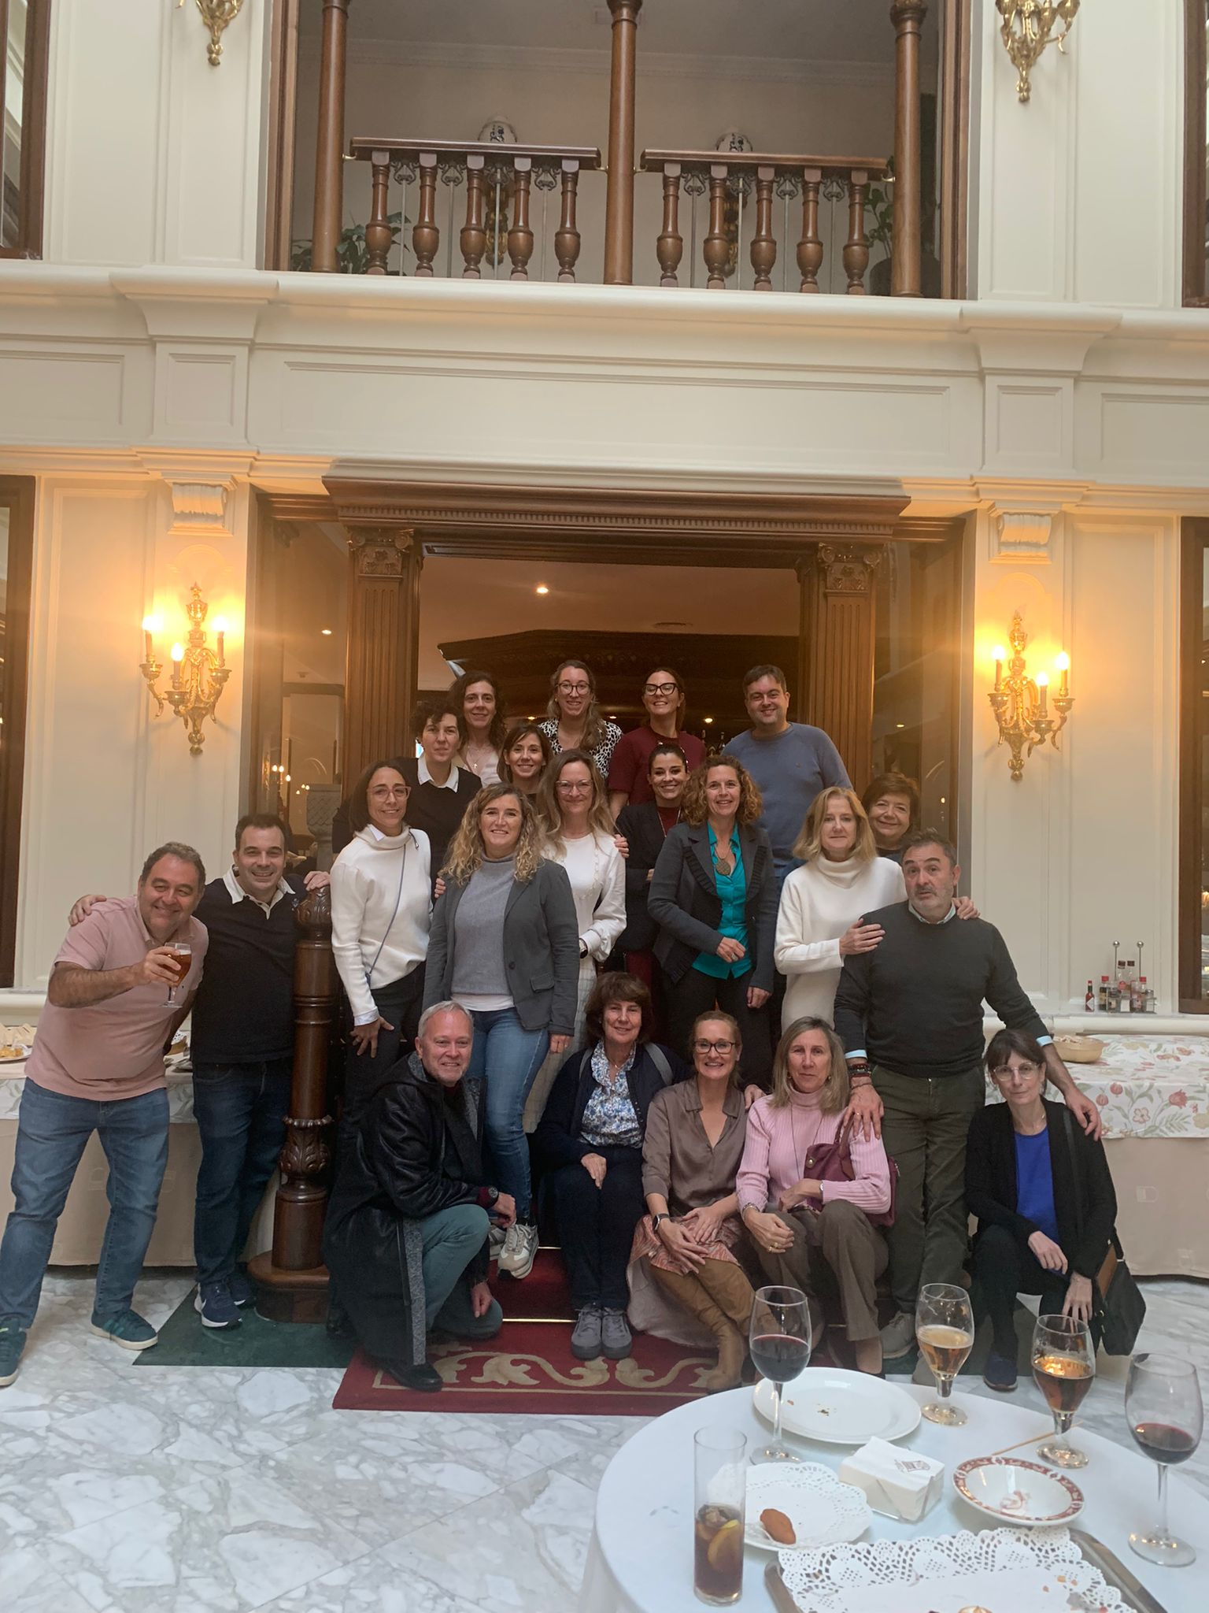
Main Insight & Activities 2024
New Governing Board 2024-2028
President: ANA LÓPEZ RICO
Carmen García elected Vice-President of Technical and Professional Development of the EIPG
1st. Drug Inspection & Control Conference
AEMPS & AEFI (Madrid, March 21)
XX Conference of Pharmacy Students CEFA (Alicante, October 15-17)
National Conference of Pharmacy Students and recent graduates CONESFAR-FEEF
(Sevilla, October 24-26)
6 collaborating associates
(New: Gerflor & Qbd Group-Azierta)
42nd AEFI SYMPOSIUM (Madrid, May 8-9). Motto: Innovation and Commitment
AEFI Ordinary General Assembly (May 8) AEFI Board Meeting (November 22-23)
New publications:
Institutional video on International Women’s Day (March 8).
Institutional Annual Report 2023
Protocol on the Prevention and Response to sexual harassment and gender-based harassment
Best Poster Award at the National Pharmacovigilance Conference
(Nov. 12-13)
Pharmacovigilance Working Group

Slide 3
Activity Plans 2025-2026
Main objectives
Strengthen our position as a scientific-technical association in the sector.
Improve the visibility of the Association.
Increase/ mantain the number of associates and partner companies.
News
New format of AEFI Symposium 2026.

Slide 4
What is appreciated form EIPG…
Annual EIPG General Assembly: networking between countries.
Expert contribution of European legislative consultations and other relevant documents.
Regular contact with European Commission and other regulatory Healthcare Administration agents.
Focused on educational and industrial pharmacists issues.

Slide 5
What is expected from EIPG…
Expert groups for discussion and write position papers for new /innovative subjects of interest of pharmacists working in Industry.
Annual or biannually position paper about the current situation of the pharmacists and their role in the Industry.
Review and update CPD (Continuing Professional Development for Qualified Persons/Regulatory Affairs).
EIPG’s membership fee is too high and there are important differences among all the member states’ contributions. AEFI’s associates should see an added value in the relationship with the Group.
Follow-up on consolidated responses to documents issued by EMA and other European institutions for public consultation.

